Slide 1
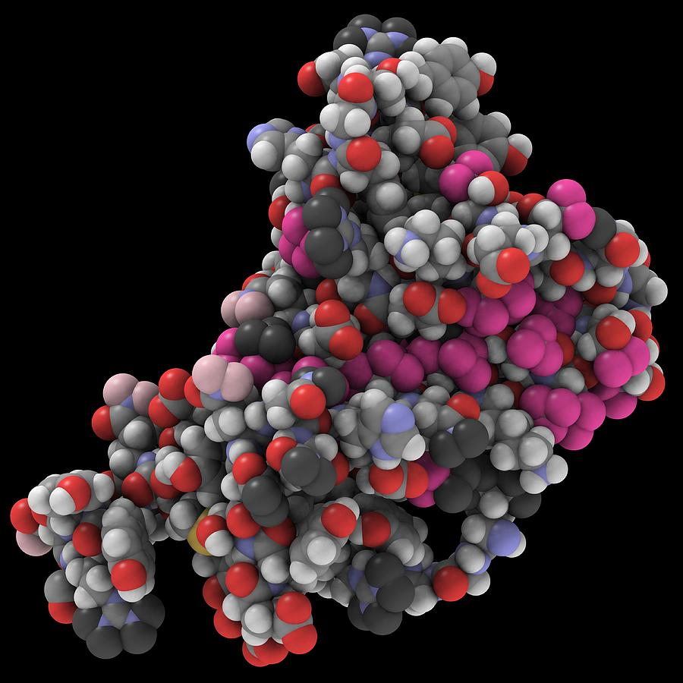
PrionX
Unveiling the Mysteries of Prions: A Journey through Prion Protein Patterns
Almog Boaron, Shani Daniel , Maggi Plutov, Eyal Blyachman
Notes:
In this lecture, we would like to introduce you to prionX.
Along with my teammates—Almog, Shani, Eyal, and myself, Maggi—we decided to choose our own topic and search for the mystery of prions and their properties

Slide 2


What are prions?
Prion proteins are a type of protein found in cells, typically with a healthy, functional structure.
They can misfold into an abnormal conformation, triggering a chain reaction where other proteins also misfold
Most prions are twisted isoforms of the major prion protein (PrP^{C}) that can abnormally fold into a pathogenic form (PrP^{Sc})
Prion formation and transmissibility remains a poorly understood phenomenon.
Notes:
First, let's establish what prions are.
Prion proteins are cellular proteins that typically exist in a healthy, functional form.
They are usually an isoform of major prion protein (PrP^c) and play a key role in cellular communication and myelin preservation.
However, under certain conditions, they can misfold into a pathological configuration (PrP^Sc) which can initiate a domino effect, causing other proteins to also misfold - a process that remains unclear.
Prions have also captured the attention of popular media.
For those curious, the show "V Wars" on Netflix explores a fictional scenario where prion diseases transform humans into vampires.

Slide 3
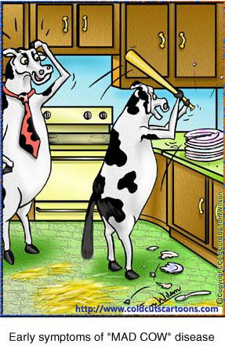
Why prions?
Increasing evidence argues that PrP^{Sc} is associated with Alzheimer’s, Parkinson’s, Creutzfeldt-Jakob, and Lou Gehrig’s diseases, as well as the tauopathies.
The pathogenesis of such illnesses seems to require prion accumulation to exceed some critical threshold before neurological dysfunction manifests.
Notes:
Why are we interested in prions?
After reaching a critical accumulation of PrP^Sc, these prion can result in neurodegenerative diseases such as the mad cow disease, and its human equivalent, קרויצפלד-יעקב disease.
both are caused by the progressive death of the brain's nerve cells, a result of the build-up of misfolded proteins in the brain.

Slide 4
Prion and prion related proteins
The universe of prion and prion-like phenomena has expanded significantly in recent years, posing challenges in classification.
Predicting which proteins can become prions requiring comprehensive understanding and experimental validation.
Conclusion: Classification of prion phenomena is an evolving process, with potential for more elaborate ontological approaches in the future.
Notes:
“prion” can have a range of meaning, such as “prion-like” and “prion-related” proteins.
Therefor, they be categorized into several key types, often presenting challenges in prion classification
For example, prion diseases are associated with structural change into a misfolded pathogenic form, which resembles many properties of amyloid fibrils.
Predicting which proteins might transform into prions is a challenge due to:
the complex nature of protein folding
the absence of conserved sequence motifs
and the context-dependent nature of prion formation.
Therefore, Prion classification is a continually evolving field and needs a deep understanding and experimental investigation.

Slide 5
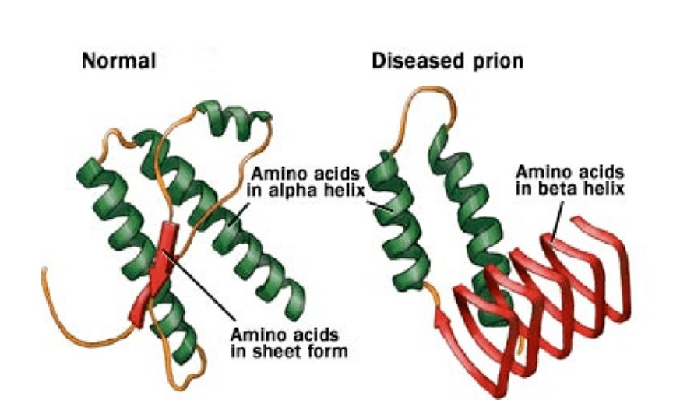
Prions distinctive properties
According to literature, Prion forming proteins are rich in Asparagine (N) and Glutamine (Q) domains.
These regions are assumed to be a driving cause for the prion structural conversion, and their propagation.
Prions are also known for their disordered composition, especially at the N/Q rich domains.
Notes:
There are a few distinctive properties we focused on,
the main ones being that Prion Forming Proteins are rich in Asparagine (אספרגין) and Glutamine (גלוטמין) domains, that are assumed to be the reason for its structural conversion and transmission.
When prions are misfolded, the normal alpha-helical structure is converted into a beta sheet.
Q/N residues play a crucial role in forming and stabilizing this structure, due to their ability to form hydrogen bonds and adopt flexible conformations.
Prions are also known for their disordered composition, especially at the Q/N rich domains which are unstable.

Slide 6
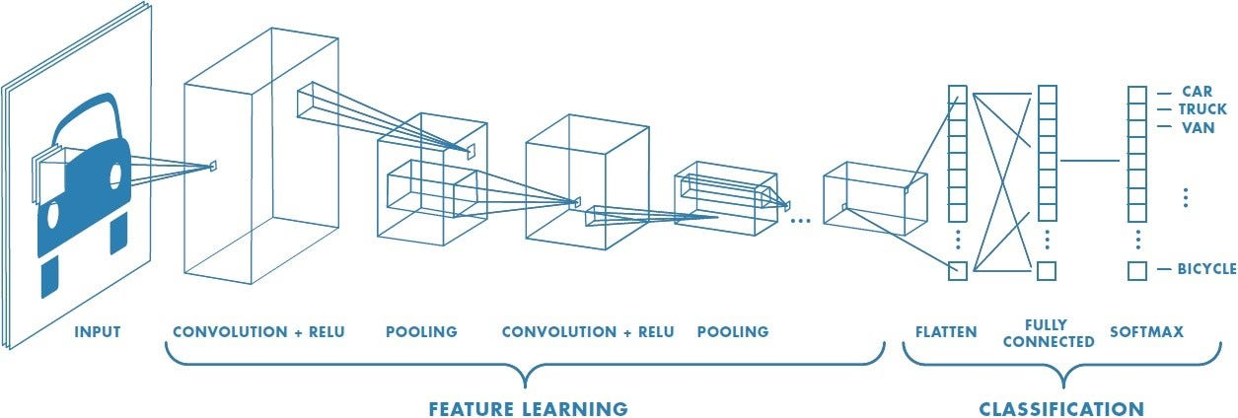
Our Approach - CNN
Main goals:
Check if this approach can distinguish prions from non-prions
Compare negative datasets of disordered proteins and globular + disordered proteins
Understand the characteristics of prions
Find new Prion folding proteins in the human genome
Notes:
We chose to base our model on these properties using convolutional neural networks (CNNs)
Our main goal was to:
characterize prions using CNNs,
distinguish prions from non-prions,
compare negative datasets of disordered proteins against globular proteins,
and identify new prion-forming proteins within the human genome.
Now, let's go over the methods we used to meet our goals.

Slide 7

Methods – Pre-Processing
1. Length filter in order too rule out the size variable of disordered proteins where they don’t have enough amino acids to form a globular hydrophobic core. Set to 40
2. Random faulty data with random letters that don’t represent amino acids.
3. Duplicates
Notes:
Our Pre Proccesing include taking out duplicates, random faulty data, and sequences smaller then 40 as they are intuitively disordered

Slide 8

Methods – Pre-Processing
MMseqs2: ultra fast and sensitive sequence search and clustering suite.
In order to overcome data leakage on our data we clustered our data with mmseq2 easy-cluster function.
Easy-cluster function clusters sequnces with 70% identity
with networkX We built a graph where each node is a sequence, and the edges are built based on the cluster.
we used connected components function in order to group our sequences.
Notes:
In order to overcome data leakage on our data we clustered our data with mmseq2 easy-cluster function that clusters data with 70% identity on these clusters we built a graph where each node is a sequence and the edges are built based on the clusters, then we used networkX connected components function inorder to group our sequncess.

Slide 9
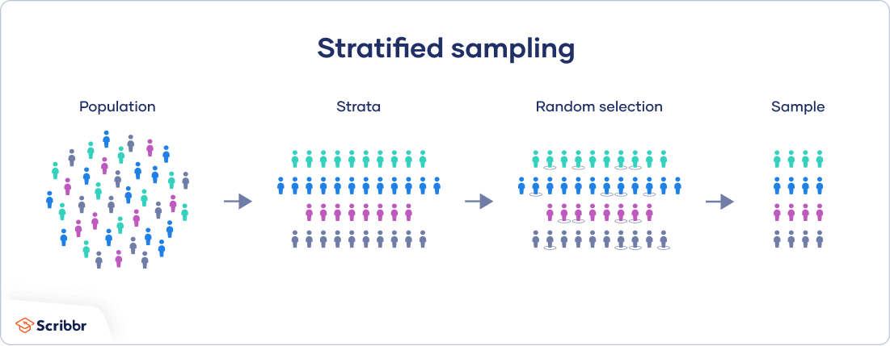
Methods – Pre Processing - Conclusion
To conclude –
Cleaned data based on length, duplicated and false annotation.
Group our data to groups of similar identity.
Divide the data in a way that the training data will differ in high sequence identity from the validation and the test (Using StratifiedGroupKFold).
Notes:
To conclude – We cleaned the data and grouped nodes that are 70% identical as the separation of the data will be by that. Thus we take out homology bias out.

Slide 10
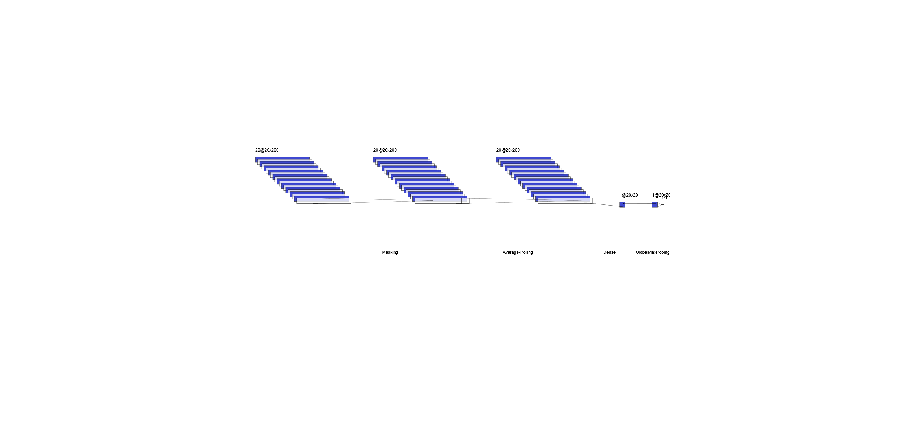
Methods – First Model
Basic model
Similar to logistic regression
No convolution layer
Step 1 – sequential() model
Step 2 – adding masking layer for variable length sequences
Step 3 – average pooling (1D) with window size 30. calculate the frequency of each amino acid in this window.
Step 4 – dense() layer with activation function ‘sigmoid’ . calculate a probability score for each window
Step 5 – max pooling (1D) . take the maximum of the scores across all windows.
Notes:
Our first model was a regular Neural Network – Very Simlar to logistic regression.
All models were sequential models.

Slide 11

Methods – First Model
Masking Layer:
The Masking layer is used to handle variable-length sequences, which is common in sequence data like proteins.
It specifies mask_value=0. to treat zeros as the mask. This means that any time step with a value of 0 will be ignored during processing.
Notes:
First we wanted our model to address variable length sequences, for that we need the masking layer set to 0 .
The value 0 will be ignored

Slide 12
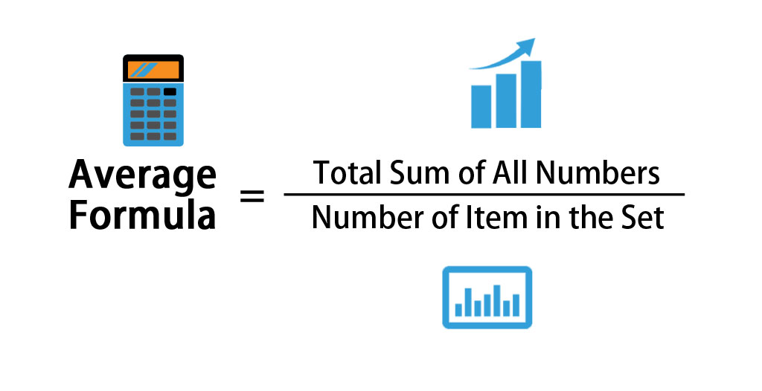
Methods – First Model
AveragePooling1D Layer:
The AveragePooling1D layer applies average pooling along the time dimension (1D) of the input sequences.
It specifies a pool_size of 30, meaning it pools adjacent 30 time steps together, thus calculating the average of appearance in each window
The strides=1 parameter indicates that the pooling window moves one time step at a time.
Notes:
The Second layer is an AveragePooling1D, with a pool size of 30 we calculate each window of amino acid row the probability of finding the amino acid in the specific step

Slide 13
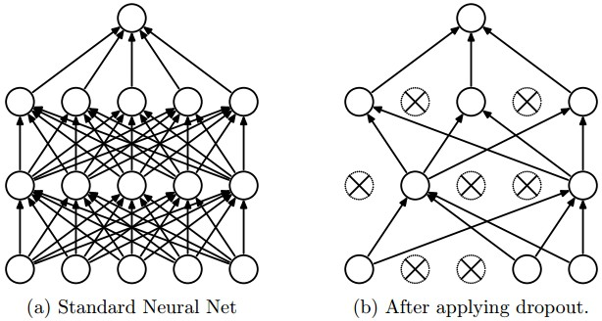
Methods – First Model
Dense Layer:
The Dense layer is a fully connected layer that maps the features extracted from the previous layers to a single output neuron.
It consists of 1 neuron (since the output is binary) and uses a sigmoid activation function. The sigmoid activation function squashes the output between 0 and 1, which is suitable for binary classification tasks.
The output value can be interpreted as the probability that the input protein sequence belongs to the "prion-forming proteins" class.
Notes:
Then A Dense layer with a single node is applied with a sigmoid activation function, this function will squash out the output between 0,1 – This output acts as the probability of this sequence being a prion forming protein.

Slide 14

Methods – First Model
GlobalMaxPooling1D Layer:
The GlobalMaxPooling1D layer applies max pooling along the amino acid dimension (1D) of the input sequences.
It takes the maximum value for each feature dimension, resulting in a fixed-length vector regardless of input sequence length.
Notes:
Then we use global max pooling 1D layer , this layer takes the maximum value for each feature dimension , resulting in a fixed length vector regardless of input sequence length

Slide 15
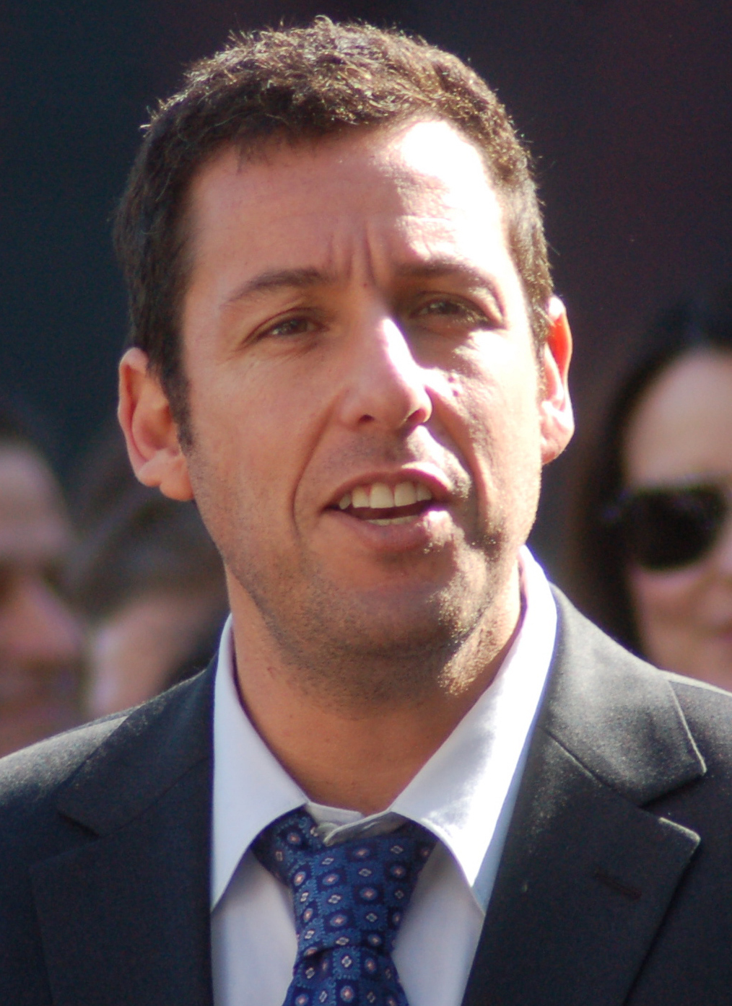
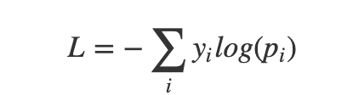
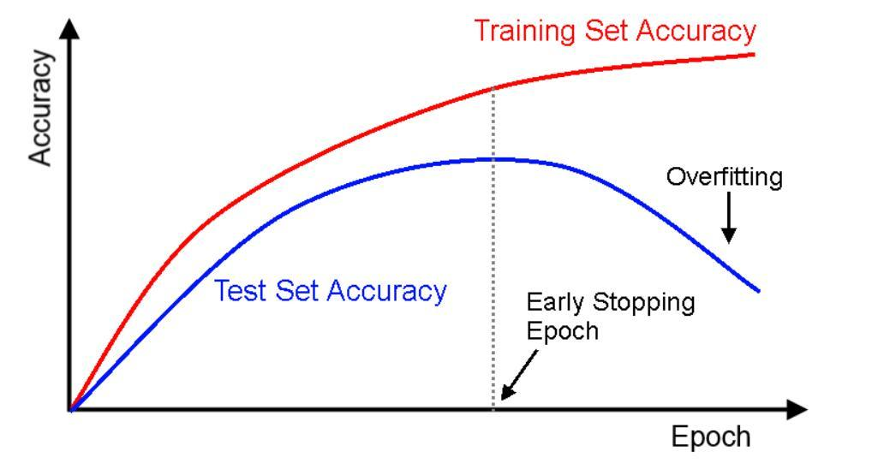
Methods – First Model
Optimizer “Adam” with learning rate 0.001 in order to fine tune our model and converge more steadily into optimized weights.
Compiling the model with loss function - binary_crossentropy – for binary (Prion\Not Prion) selection
Using early stopping on high number of epochs in order to avoid overfitting of the data by monitoring the val_loss
Notes:
This model was compiled with – Adam Optimizer with a learning rate of 0.001 and Loss Function – Binary Crossentropy
And we applied early stopping to the process to avoid overfitting.

Slide 16
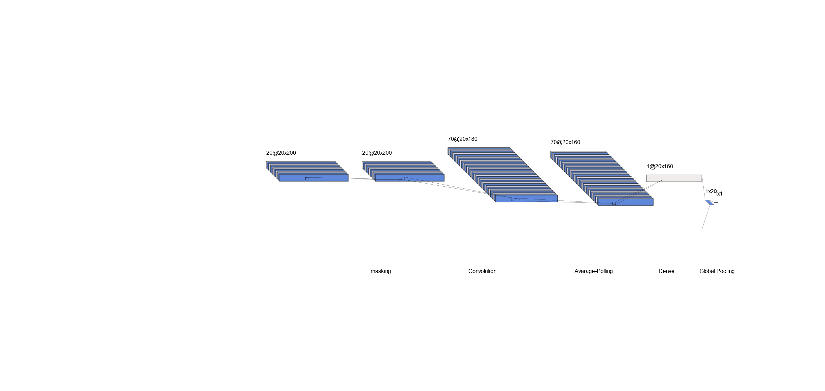
Methods – Advanced Model
advanced model
Including one convolutional layer
Early stopping
Kernal optimization and regularizer
Step 1 – sequential() model
Step 2 – adding masking layer for variable length sequences
Step 3 – convolutional layer with the following parameters: filters=256, kernel_size=25, activation='relu', kernel_regularizer=l1(0.001)
Step 4 – average pooling (1D) with window size 30. calculate the frequency of each amino acid in this window.
Step 4 – dense() layer with activation function ‘sigmoid’ . calculate a probability score for each window
Step 5 – max pooling (1D) . take the maximum of the scores across all windows.
Notes:
The Difference between the first model and the second one is 1 simple convolution layer.

Slide 17

Methods – Advanced Model
Convolution Layer 1 Dimension –
we create 256 filters where each filter will try to capture different patterns from the input data.
Our Kernel size was set to 25 thus for each step of 25 amino acids along the sequence
Activation Function Relu was used in order to introduce non linearity to the network.
Kernel regularizer with hyper parameter 0.001 was used to help prevent overfitting by penalizing large weights in this layer
Notes:
The convulotion properties as such: 256 filters kernel size 25 activation function relu and with a kernel regularize the hyperparamerter 0.001

Slide 18
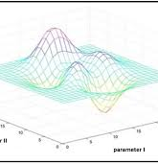
Methods – Advanced Model
Grid Search optimization of kernel size and number of filters:
In order to choose the best kernel size and number of filters we ran a simple grid search of different number of kernels and filters to find the optimal configuration based on our chosen matric – accuracy
Notes:
To chose the number of filters and kernel sizes we used a grid search optimization to find the best hyperparameters inorder to get the best accuracy metric.

Slide 19
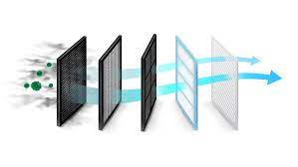
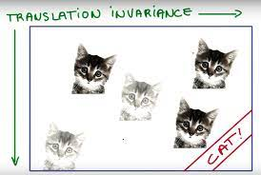
Methods – Advanced Model
Conclusion –
Better feature extraction by applying convolutional filters to the input the layer identifies patterns. These features are learned automatically during the training process, allowing the model to capture important characteristics of the data without manual feature engineering.
Advantage of translation invariance, By sharing weights across different spatial locations the model learns to recognize patterns regardless of their exact position in the input.
Notes:
The Advance model is capable of better feature extraction , as each filter tries to acquire different motifs for prion forming motifs,
Also uses the translation invariance hypothesis, as such learns to recognize patterns regardless of their exact position in the input.

Slide 20
Methods – Conclusion
We used 2 dataset and 2 models for each.
So in total we have 4 trained models.
Data Set 1 Prions VS Disordered Proteins
Data Set 2 Prions VS Disordered + Globular Proteins
Basic CNN
Advanced CNN
Basic CNN
Advanced CNN

Slide 21
Results - Accuracy and Loss Metrics
CNN Models on Data set 1 (disordered proteins vs prions):
CNN Models On Data set 2 (disordered & globular vs prions):
Model | Accuracy | Loss (BCE)
Basic CNN | 0.786033 | 0.641325
Advanced CNN | 0.832095 | 0.459483
Model | Accuracy | Loss (BCE)
Basic CNN | 0.720701 | 0.560538
Advanced CNN | 0.851041 | 0.434653
Notes:
We are observing the metrics of the 4 models – the accuracy is the fraction of right predictions out of the whole test set, and the loss function used is binary crossentropy, with a lower loss being better. We can see we got the highest accuracies and lowest losses in the advanced CNNs, and overall these metrics are not bad when using convolution.
The model which also includes the globular proteins in the negative dataset has a slightly better accuracy and loss here.

Slide 22
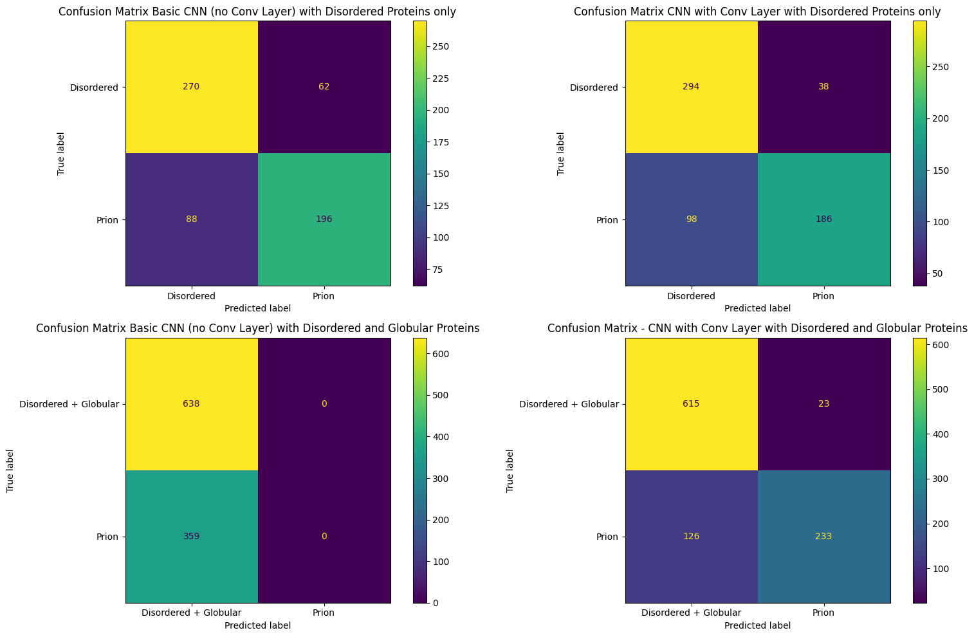
Confusion Matrices (Advanced Models)
True Positive Rate (TPR): 0.655
False Positive Rate (FPR): 0.114
True Negative Rate (TNR): 0.886
False Negative Rate (FNR): 0.345
True Positive Rate (TPR): 0.649
False Positive Rate (FPR): 0.036
True Negative Rate (TNR): 0.964
False Negative Rate (FNR): 0.351

Slide 23
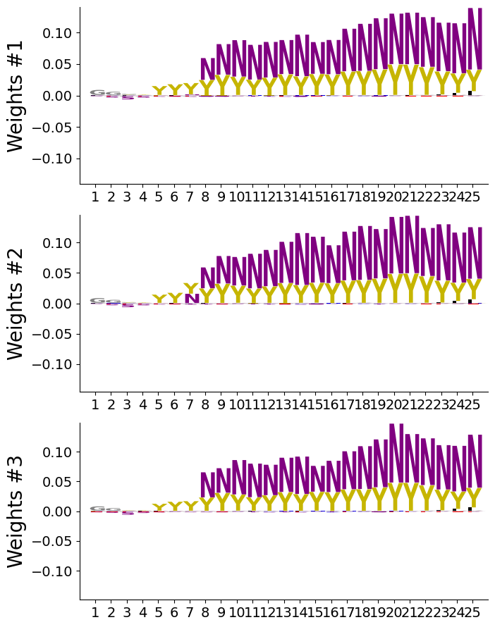
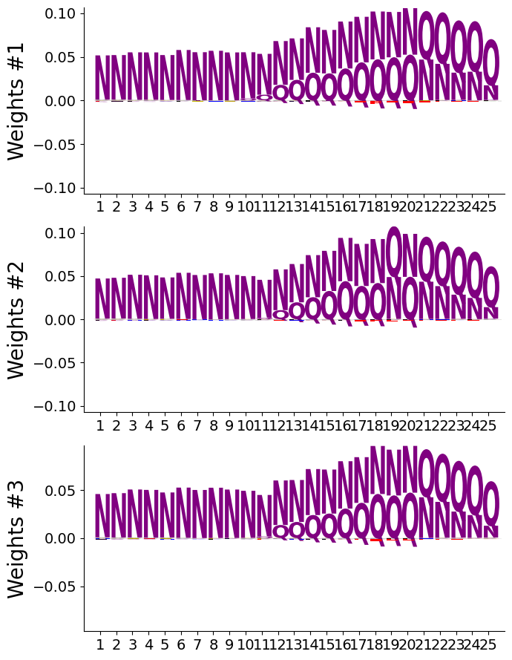
Amino Acids Weights Visualization
Dataset 1 – prions vs disordered
Dataset 2 – prions vs disordered+globular
Notes:
Now we are looking at a visualization of the weights of amino acids. The higher an Amino acid weight is, the more it contributes, or the more important it is to the differentiation between is the protein a prion or not. We can say it’s the coefficient given to this amino acid. The X axis is the kernel size – 25 kernels being 25 columns, and we are looking at the top 3 most important features from the features we used in the models.
We can see here that as expected by the literature, asparagine, which is N, is very important in the classification of prions in both models, meaning with both negative datasets.
When adding the globular proteins to the negative dataset, glutamine, which is Q, is also relatively significant, as we would also expect. However, when only looking at disordered proteins vs prions, we can see that the amino acid tyrosine, which is Y, also got some significance. Tyrosine is hydrophobic, This could be due to the hydrophobic core of proteins that might be a bit scrambled and undefined in disordered proteins, making it another factor for comparing between them and prions.
Weights of amino acids in the 3 most important features – CNNS with convolution . Each column is a kernel.
We can see, as expected from the known literature, that asparagine (N) and glutamine (Q) have a high weight
Amino Acid Y – tyrosin, hydrophobic. Disordered proteins might have a less recognizable hydrophobic core, which might be the cause of the also high importance of tyrosine, that is not shown with globular proteins as well.
Each column is a kernel

Slide 24
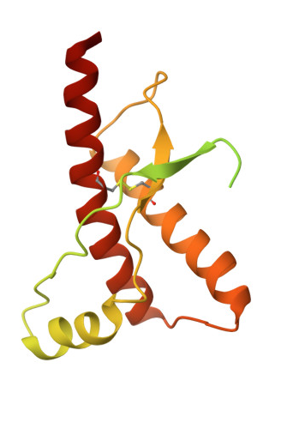
Finding Prions In The Human Genome
Checking total of 12,281 genes in the human genome (genes with the size of 500 AA or less)
With specific attention to:
“human prion 1” – PRIO_HUMAN Major prion protein
“human prion 2” – PRND_HUMAN Prion-like protein doppel
“human prion 3” – SPRN_HUMAN Shadow of prion protein
“human prion 4” – APRIO_HUMAN Alternative prion protein
“human prion 5” – PRNT_HUMAN Putative testis-specific prion protein
Notes:
Lastly, we wanted to check how well our models perform in predicting prions in the human genome. We only included genes in the human genome that have 500 amino acids or less for simplicity, and got a total of 12,300 genes that we ran the models on. We also wanted to pay attention to proteins that are related to prions in the human genome and see the ranks we get for them in terms of probability to be a prion. The first prion – human prion 1 , is a major prion protein which has a direct affect on CJD, so we would expect its rank to be lower, meaning more likely to be a prion. Human prion 2 here is also associated with CJD but in a less direct association, and has some prion properties, so we would expect him to get a low rank as well. The last 3 human prions here, ae not really prions but are associated to prions, for example have a similar structure or even regulate prion activities and so on. We would probably expect then to not necessarily have a high probability to be prions but we’ll see.
CJD is caused by variants affecting the gene PRIO_HUMAN
CJD is also associated to mutations in PRND_HUMAN
SPRN_HUMAN - Prion-like protein that has PrP(C)-like neuroprotective activity. May act as a modulator for the biological actions of normal and abnormal PrP (By similarity).
APRIO_HUMAN – has a repeated region. Mutations in the repeat region as well as elsewhere in this gene have been associated with Creutzfeldt-Jakob disease, fatal familial insomnia, Gerstmann-Straussler disease, Huntington disease-like 1, and kuru.
PRNT_HUMAN – seems to resemble a prions structure, but couldn’t find data about its association to actual prions / prion activity.

Slide 25
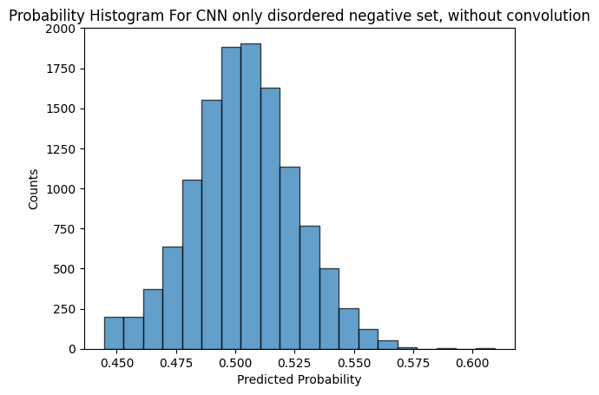
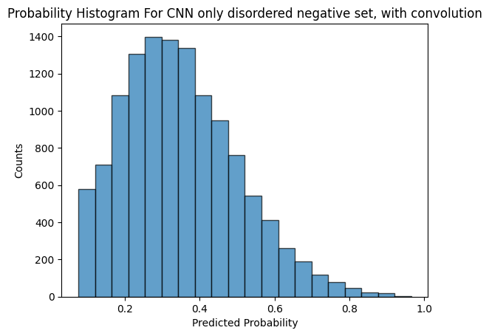
Finding Prions In The Human Genome
rank for “human prion 1” - 665
rank for “human prion 2” - 5203
rank for “human prion 3” – 12,052
rank for “human prion 4” – 12,041
rank for “human prion 5” – 1,462
rank for “human prion 1” - 12
rank for “human prion 2” - 630
rank for “human prion 3” – 11,114
rank for “human prion 4” – 12,265
rank for “human prion 5” – 11,387
Notes:
So, regarding the first dataset with disordered proteins vs prions, we can see that we got less prion predictions when using a convolutional layer, here the center of the probabilities is lower than the basic model. and also low ranks as we expected for human prions 1 and 2, especially 1 with a very low rank of 12, meaning it’s the 12th protein with the highest probability to be a prion. reminding that’s out of 12,300 proteins. The last 3 proteins got a very high rank, meaning we have predicted they have a very low probability to be prions, which is also okay considering our knowledge of them. Without convolution the ranks are much more random we can say, still prion 1 got the lowest rank but prion 2 for example got a pretty high rank, so the basic model is probably not as good.

Slide 26
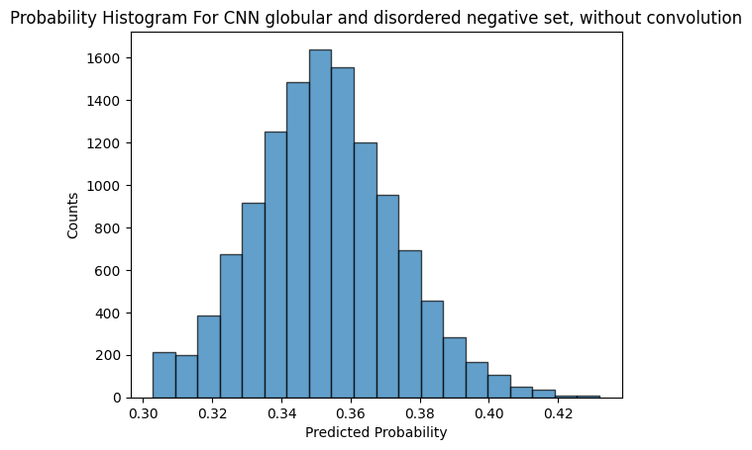
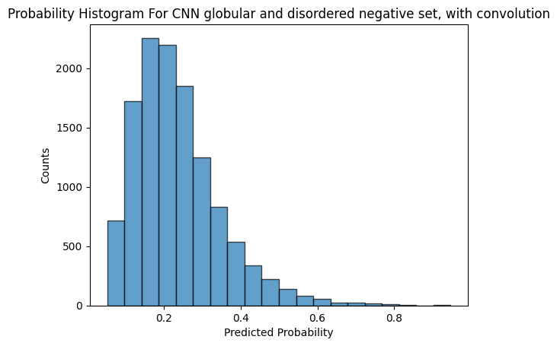
Finding Prions In The Human Genome
rank for “human prion 1” - 8993
rank for “human prion 2” - 3277
rank for “human prion 3” - 9279
rank for “human prion 4” - 4533
rank for “human prion 5” - 4103
rank for “human prion 1” - 350
rank for “human prion 2” - 556
rank for “human prion 3” – 11,984
rank for “human prion 4” – 12,108
rank for “human prion 5” – 11,477
Notes:
And these are the models on second dataset, that also includes globular proteins. The center of the prediction using a convolutional layer seems to be lower here as well (than the basic model), and the ranks also align with our predictions – the ranks for proteins 1 and 2 are still pretty low and the others are very high. In the basic model we see relatively random results regarding the proteins we check.

Slide 27

Discussion
Our Pipeline:
Build Data set Prions vs Other Proteins
Preprocess steps -> group by homologs
Build and fine tune CNN
Check Proteomes
Notes:
To Sum up our pipeline:
First, we collected data: prions and a negative set of proteins (disordered and globular)
We preprocessed it and split it to train, validation and test
We build and fine tune the CNN
And eventually we checked the model on new data (protemoes) and compared with known benchmark tools

Slide 28
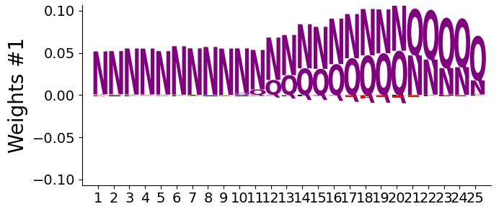

Success
Our model successfully identified compositional features known about prions – regions with N, Q residues ☺
Notes:
Great Success Our compositional model was able to identify N (Aspirigne) and Q (Glutamine) as most important amino acids to classify prions – and it supports what is known in literature.

Slide 29
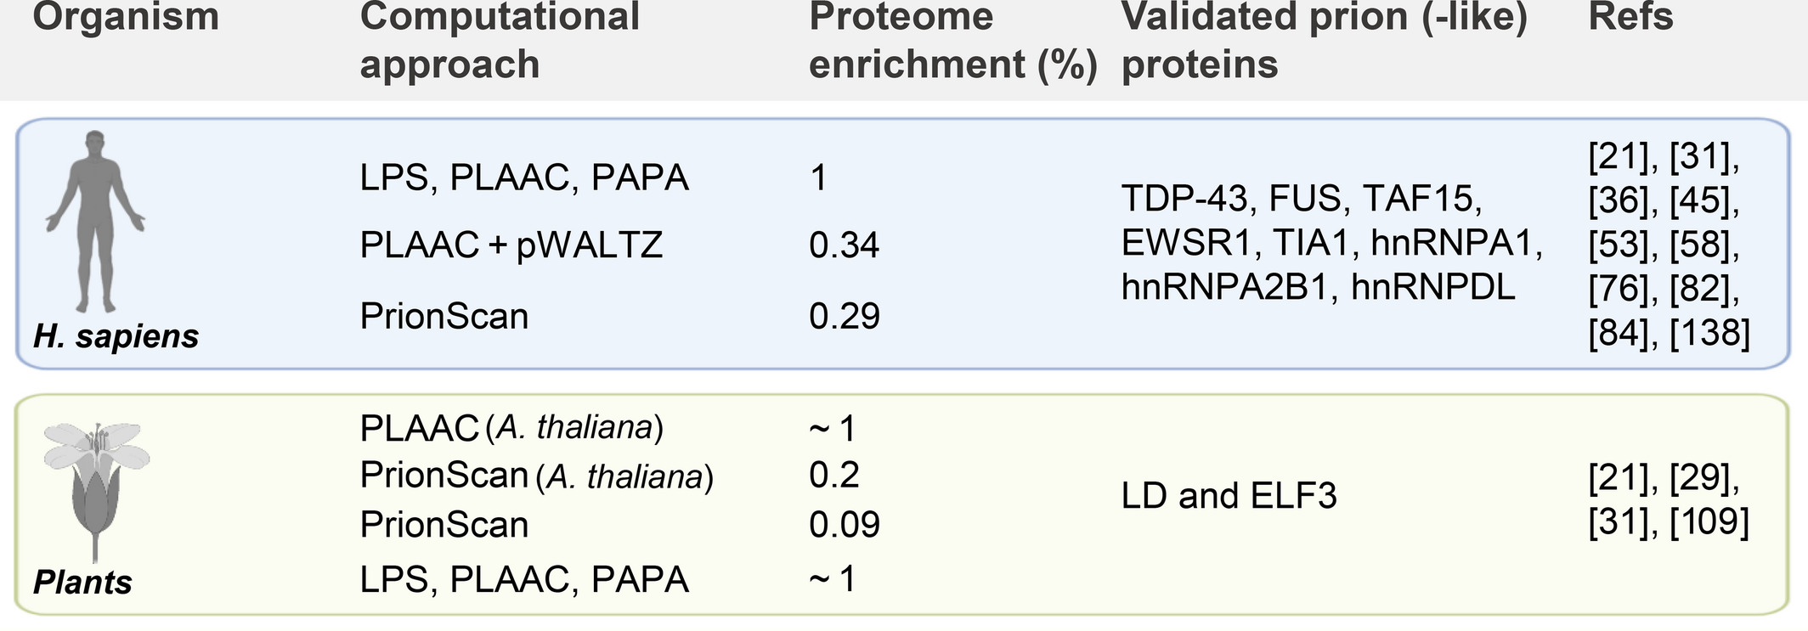
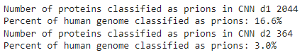
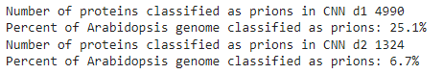
Not Really
We are still far from a proper model ☹
Prion-like proteins: from computational approaches to proteome-wide analysis (https://febs.onlinelibrary.wiley.com/doi/full/10.1002/2211-5463.13213)
Notes:
But it’s not all sunshine Comparing to other tools that identify prions from past years research we can see our model is not so accurate.
Here we can see the percent of prions found in the human genome and Arabidopsis geonome – our model gets - 3% vs 1% and less in humans and 6.7% vs 1 and less in arabidopsis

Slide 30
Human Prions Predictions
 | Genes | model_1_pred | model_2_pred | d2_model_1_pred | d2_model_2_pred
2032 | MANLGCWMLVLFVATWSDLGLCKKRPKPGGWNTGGSRYPGQGSPGG... | 0.539081 | 0.888120 | 0.339745 | 0.503626
13593 | MRKHLSWWWLATVCMLLFSHLSAVQTRGIKHRIKWNRKALPSTAQI... | 0.507200 | 0.627681 | 0.364502 | 0.459440
15038 | MNWAPATCWALLLAAAFLCDSGAAKGGRGGARGSARGGVRGGARGA... | 0.454865 | 0.155283 | 0.338311 | 0.079279
16818 | MEHWGQPIPGAGQPWRQPLPTSGRWWLGAASWWWLGAASWWWLGAA... | 0.455151 | 0.075199 | 0.358389 | 0.068900
19619 | MQHSLVFFFAVILHLSHLLHLDASIHPFRLPFSSKPFLLIPMSNTT... | 0.529354 | 0.142028 | 0.360302 | 0.102102

Slide 31
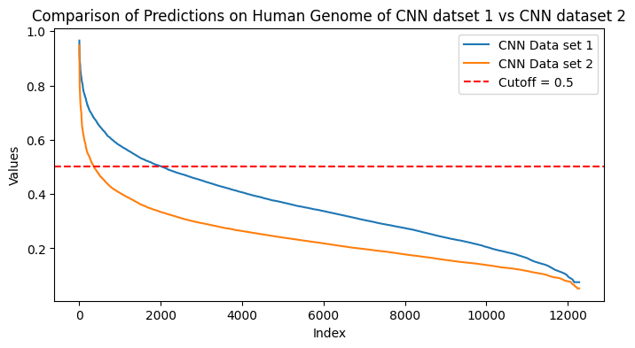

Data matters
The Negative Set we use matters a lot!
Data Set 1 -> Better Human Prion identification (ranked 12!)
Data Set 2 -> More sensitive in amounts
Notes:
Another key point is that data mattes, obviously
Obviously, the data we use impacts the model performance.
Using only disoredred proteins as a negative set, the model gave a better score to the known human prion involved in Creutzfeldt–Jakob disease (it was ranked 12).
But when using globular and disordered, the model was more sensitive and classified less proteins as Prions – which is more accurate.
If we choose 0.5 as cut off for prions, we get much less prions in the orange curve (around 300 vs 2000 in the blue curve)
On Data set 1 (only disordered), the model gave better score to the known human prion involved in Creutzfeldt–Jakob disease (it was ranked 12).
On Data set 2 (globular and disordered), the model was more sensitive and classified less proteins as Prions – which is more accurate.
If we choose prediction higher than 0.5 to be labeled as prions we get much less prions in the orange curve (364 vs 2044)

Slide 32
Data Effects on Model Results
Different predictions between models
Prediction Similarity between models
Protein seq | name | CNN data1 pred | CNN data2 pred
MDQNNSLPPYAQGLASPQGAMTPGIPIFSPMMPYGTGLTPQPIQNT… | TATA-box-binding protein | 0.289791 | 0.947320
MQQQQQQQQQQQQQQQQQQQQQQQQQQQQQQQQQQQQQQQQQQQQQ… | Ataxin-8 | 0.075199 | 0.936216
Protein seq | name | CNN data1 pred | CNN data2 pred
MKFTIVFAGLLGVFLAPALANYNINVNDDNNNAGSGQQSVSVNNEH… | Gastrokine-1 | 0.965796 | 0.920569
MPAENSPAPAYKVSSHGGDSGLDGLGGPGVQLGSPDKKKRKANTQG… | Pygopus homolog 1 | 0.939643 | 0.903039
Notes:
On specific protein that was ranked in Top 5 in both models was Gastrokine, anti-amyloidogenic protein, can prevent formation of amyloid fibers, which can be considered a bit anti-prion. It’s interesting maybe the CNN model can discover anti-prion proteins and (maybe reveal the truth about prions – that their real purpose is to prevent amyloids but somehow they got messed up and caused the opposite.)
Another example is Ataxin-8, a nearly pure polyglutamine expansion protein which causes neurodegenerative disorder.
However we can see there are proteins not related to Prions at all like Tata box binding protein and Pygopus which has a role in embryonic development.

Slide 33
New Models Results
Proteins with high score in both models
Protein seq | name | CNN data1 pred | CNN data2 pred
MKFTIVFAGLLGVFLAPALANYNINVNDDNNNAGSGQQSVSVNNEH… | Gastrokine-1 | 0.965796 | 0.920569
MPAENSPAPAYKVSSHGGDSGLDGLGGPGVQLGSPDKKKRKANTQG… | Pygopus homolog 1 | 0.939643 | 0.903039
MNWHMIISGLIVVVLKVVGMTLFLLYFPQIFNKSNDGFTTTRSYGT… | C-type lectin domain family 5 member | 0.910259 | 0.790942
Notes:
Another interesting observation is inconsistency between the models, a protein can get a high score in one model and very low in the other.
We saw some inconsistency between the models, a protein can get a high score in one model and very low in the other.
But some proteins got high scores on both models.
Gastrokine is an anti-amyloidogenic protein, it can prevent formation of amyloid fibers (amyloid aggregation is a bit similar to prion phenomena), so maybe it can be viewed as anti-prion (and they have similar properties as prions)
Other 2 proteins seem not to be related at all:
2) Pygopus has a role in embryonic development.
3) C-type Lectin proteins have diverse range of functions, including: cell-cell adhesion and immune response to pathogens.

Slide 34
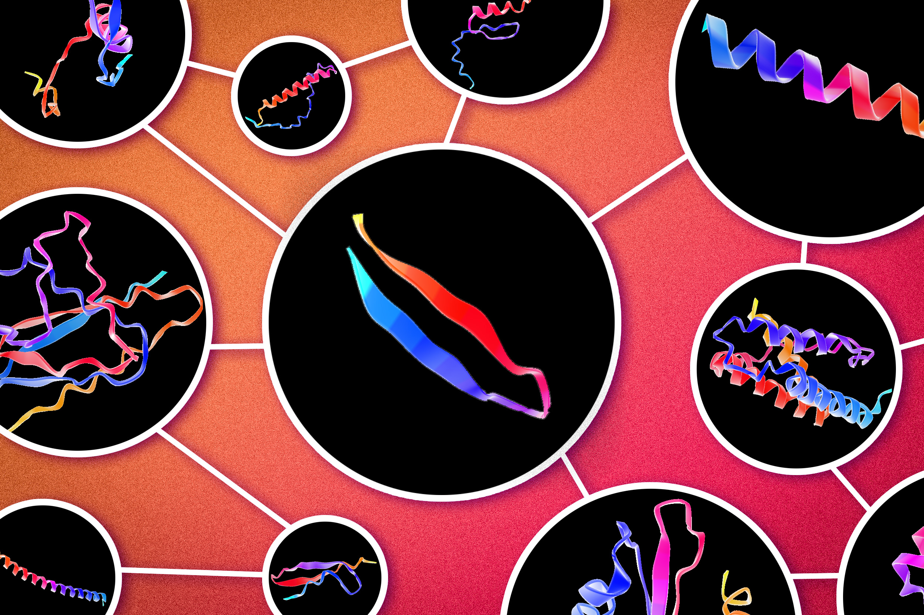
Conclusion & Future Steps
So What is the best Model???
Further research:
More protein data
Other proteins
Structure data
Enhance CNN capabilities
Notes:
So it is hard to conclude which model is better, but we would say it’s CNN with convolution layer trained on data set of disordered and globular proteins.
It uses more data, its results match the literature better, and it’s more sensitive (less false positives)
We believe there is much more research can be done using CNN.
We can enrich the data for the models and try new approaches with structural data
And of course, try more complex variations of the CNN

Slide 35


Slide 36
References
Harrison, P.M., Gerstein, M. A method to assess compositional bias in biological sequences and its application to prion-like glutamine/asparagine-rich domains in eukaryotic proteomes. Genome Biol 4, R40 (2003). https://doi.org/10.1186/gb-2003-4-6-r40
Harbi D, Parthiban M, Gendoo DMA, Ehsani S, Kumar M, Schmitt-Ulms G, et al. (2012) PrionHome: A Database of Prions and Other Sequences Relevant to Prion Phenomena. PLoS ONE 7(2): e31785. https://doi.org/10.1371/journal.pone.0031785
Djamel Harbi & Paul M Harrison (2014) ­Classifying prion and prion-like phenomena, Prion, 8:2, 161-165, DOI: 10.4161/pri.27960
Gil-Garcia, M., Iglesias, V., Pallarès, I. and Ventura, S. (2021), Prion-like proteins: from computational approaches to proteome-wide analysis. FEBS Open Bio, 11: 2400-2417. https://doi.org/10.1002/2211-5463.13213
https://github.com/jertubiana/PGM

